Slide 1
Year 11 – Paper 2 & 3 Revision Pack (Foundation)
Please attempt all questions with a calculator.
Paper 2: Tuesday 7th June 2022
Paper 3: Monday 13th June 2022

Slide 2
How to use this revision pack
Review the list of topics that will appear on paper 2 and 3 of the summer exams. The booklet is divided into two parts; the first half is preparation for paper 2 and the second half is for paper 3.
Work through the revision pages for each of the topics that will appear on the summer exams.
Use the electronic mark scheme to check your work and identify areas of weakness. The electronic mark scheme can be found on Teams and Satchel One.
Follow up with either:
Using the Hegarty Maths Clip Numbers to watch video tutorials on areas of weakness. You should then complete the quizzes on Hegarty to test whether you have closed your gap in knowledge.
OR
B. Follow the link for Maths Genie Exam Practice and search for the pack of questions relating to each topic (Mark Schemes Provided)
Each of these options is clearly labelled at the bottom of each page of revision.
You can also access whole past papers at https://corbettmaths.com/2022/02/28/edexcel-gcse-foundation-summer-2022/ You should select Advanced Information – Paper 2 and 3 (Set A and Set B)
Email your class teacher if you have any questions.

Slide 3
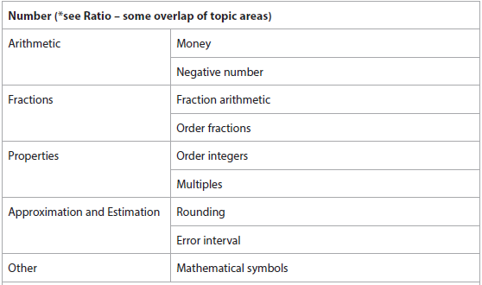
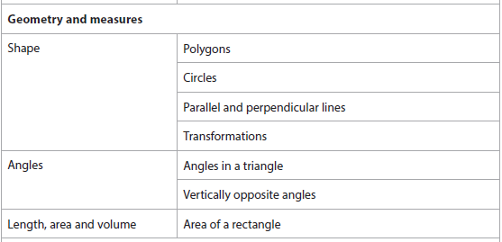
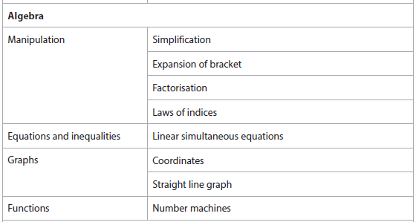
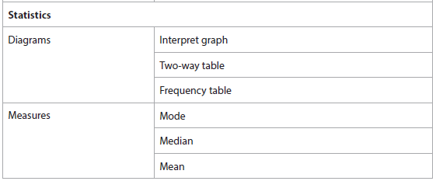
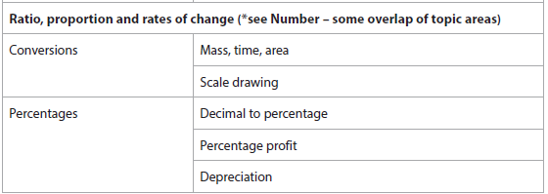
Advanced Information – 2F
Calculator

Slide 4
Section A: Number

Slide 5
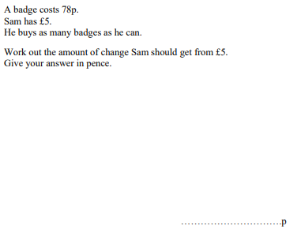
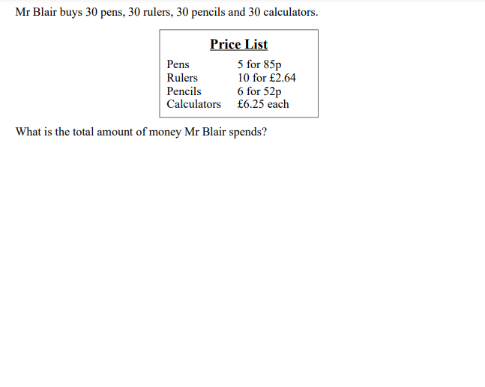
Money
FOLLOW-UP WORK
Clips 743-754
https://www.mathsgenie.co.uk/gcse-may-june-2022-foundation-topics.html

Slide 6
Negative Number
$$Work out \\ 5−14$$ $$−5 −14$$ $$14 −(−5)$$ $$−14 −(−5)$$ | $$Work out \\ −2×−3$$ $$−4 ×−8$$ $${(−25)}^{2}$$ $${(−5)}^{3}$$
$$Work out$$ $$−125 ÷5$$ $$−96 ÷−4$$
FOLLOW-UP WORK
Clips 37-44
https://www.mathsgenie.co.uk/gcse-may-june-2022-foundation-topics.html Negative Numbers

Slide 7
Fraction Arithmetic
For these questions, you need to show your full working out.
$$3\frac{2}{5}×1\frac{3}{4}$$ | $$3\frac{2}{5}÷1\frac{3}{4}$$
$$3\frac{2}{5}+1\frac{3}{4}$$ | $$What number is halfway between\frac{2}{5}and\frac{3}{4}?$$
FOLLOW-UP WORK
Clips
65-70,80
https://www.mathsgenie.co.uk/gcse-may-june-2022-foundation-topics.html
Fractions

Slide 8
Ordering Numbers
$$Order the following numbers. \\ Start with the smallest number.$$ $$8, 2, −4, 0, −7$$ | $$Order the following numbers. \\ Start with the smallest number.$$ $$\frac{2}{3} \frac{3}{5} \frac{7}{10}$$
$$Order the following numbers. \\ Start with the largest number.$$ $$5, −2, −1, 8, −125$$ | $$Which fraction is closer to\frac{1}{2}$$ $$\frac{3}{10} or \frac{5}{7}$$ $$Explain your answer.$$
FOLLOW-UP WORK
Clips
14,37&60
https://www.mathsgenie.co.uk/gcse-may-june-2022-foundation-topics.html
Writing, Simplifying and Ordering Fractions

Slide 9
Multiples
$$List the first five multiples of 8$$ $$List the first five multiples of 0.8$$ | $$Write down all the multiples of 4 between \\ 30 and 50$$
$$What is the next even multiple of 7 after 42?$$ | $$Multiples of a number are always larger than$$ $the number itself.Comment on this statement.$
FOLLOW-UP WORK
Clip 33
https://www.mathsgenie.co.uk/gcse-may-june-2022-foundation-topics.html
Factors & Multiples

Slide 10
Rounding
$$Round 45 384:$$ $$To the nearest 10$$ $$To the nearest 100$$ $$To the nearest 1000$$ $$To the nearest 10000$$ | $$Round to the nearest integer \left(whole number\right):$$ $$5.627$$ $$0.573$$ $$29.999$$
$$Round 3.682$$ $$To one decimal place$$ $$To two decimal places$$ | $$Round to one significant figure:$$ $$45 284$$ $$2.7446$$ $$0.00782$$
FOLLOW-UP WORK
Clips 17, 56, 130 and 133
https://www.mathsgenie.co.uk/gcse-may-june-2022-foundation-topics.html Rounding

Slide 11
Error Intervals
$$A number that has been rounded to the nearest$$ $hundred is 500. Write this as an error interval$. $…≤x < …$ | $$A number that has been rounded to 2 decimal$$ places is 1.46. $Write this as an error interval$. $…≤x < …$
$$A number that has been rounded to 2 significant$$ figures is 2400. Write this as an error interval. $…≤x < …$ | $$A number that has been truncated to 1 decimal$$ place is 1.5. $Write this as an error interval$. $…≤x < …$
FOLLOW-UP WORK
Clips 774-777
https://www.mathsgenie.co.uk/gcse-may-june-2022-foundation-topics.html
Error Intervals

Slide 12
Mathematical Symbols
$$Complete the blank with either <, >, or=$$ 4 6 -2 -9 | $$Complete the blank with either <, >, or=$$ 0.45 0.405 0.2 0.19
$$Complete the blank with either <, >, or=$$ $\frac{3}{4}$ $\frac{4}{5}$ | $$Complete the blank with either <, >, or=$$ $\frac{9}{15}$ $\frac{12}{20}$
FOLLOW-UP WORK
Clip 14
https://www.mathsgenie.co.uk/gcse-may-june-2022-foundation-topics.html

Slide 13
Section B: Algebra
Simplification was also in Paper 1. Please use your old booklet to revise this topic.

Slide 14
Expansion of Brackets
$$Expand:$$ $$4\left(x+7\right)$$ $$2(10 −x)$$ $$3(5x −2)$$ | $$Expand:$$ $$x\left(x+7\right)$$ $$4x(x+7)$$ $$4x(10 −x)$$
$$Expand and simplify:$$ $$4\left(10 −3x\right)−2(x−4)$$ | $$Expand and simplify:$$ $$(x+5)(x −7)$$
FOLLOW-UP WORK
Clips 160-161
https://www.mathsgenie.co.uk/gcse-may-june-2022-foundation-topics.html Expanding and Factorising

Slide 15
Factorisation
$$Factorise:$$ $$10x+25$$ $$15x−9$$ $$3x+6y −15z$$ | $$Factorise:$$ $$x^{2}+25x$$ $$2x^{2}y+10xy$$ $$4x^{3}−10x$$
$$Factorise:$$ $$x^{2}+10x+21$$ | $$Factorise:$$ $$x^{2}−10x+21$$ $$x^{2}−4x−21$$
FOLLOW-UP WORK
Clips 168-171; 223, 224
https://www.mathsgenie.co.uk/gcse-may-june-2022-foundation-topics.html Expanding and Factorising

Slide 16
Laws of Indices
$$Simplify:$$ $$x^{5}÷x^{9}$$ $$x^{−3}×x^{9}$$ $${{(x}^{4})}^{5}$$ | $$Simplify:$$ $$4x^{9}÷{2x}^{3}$$ $${5x}^{4}×x^{7}$$ $$({2xy^{4})}^{3}$$
$$Evaluate:$$ $$5^{4}$$ $$5^{0}$$
FOLLOW-UP WORK
Clips 173, 174
https://www.mathsgenie.co.uk/gcse-may-june-2022-foundation-topics.html Indices

Slide 17
Simultaneous Equations
Solve the following simultaneous equations: $$5x+4y=18 \\ 3x+4y=6$$ | Solve the following simultaneous equations: $$4x−2y=16 \\ 3x+4y=23$$
Solve the following simultaneous equations: $$5x−2y=8 \\ 6x+3y=42$$ | 5 pens and 2 rulers cost £3.20. 6 pens and 3 rulers cost £4.20. How much does each item cost?
FOLLOW-UP WORK
Clips 190-195; 218-219
https://www.mathsgenie.co.uk/gcse-may-june-2022-foundation-topics.html Simultaneous Equations

Slide 18
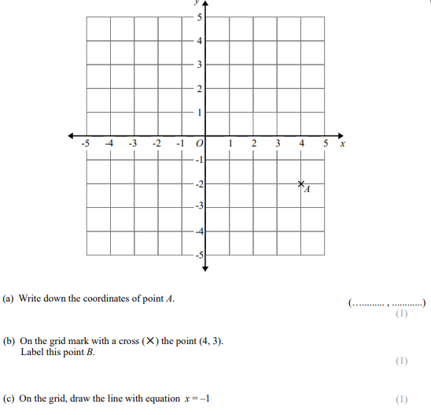
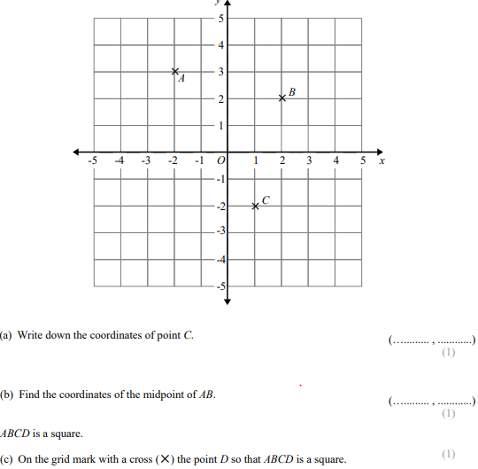
Coordinates
FOLLOW-UP WORK
Clips 199-200
https://www.mathsgenie.co.uk/gcse-may-june-2022-foundation-topics.html Coordinates

Slide 19
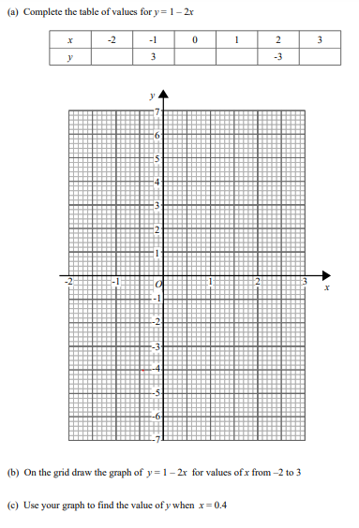
Straight Line Graphs
FOLLOW-UP WORK
Clips 205-210
https://www.mathsgenie.co.uk/gcse-may-june-2022-foundation-topics.html Drawing Graphs

Slide 20
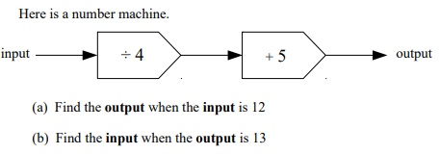
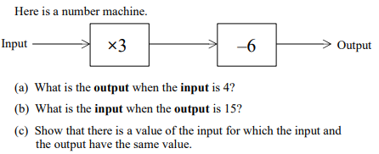
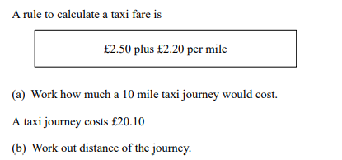
Number Machines
FOLLOW-UP WORK
Clips 176-177
https://www.mathsgenie.co.uk/gcse-may-june-2022-foundation-topics.html Function Machines

Slide 21
Section C:
Ratio, Proportion & Rates of Change
Write as a ratio and Use of Ratio was also in Paper 1. Please use your old booklet to revise this topic.
Direct Proportion was also in Paper 1. Please use your old booklet to revise this topic.

Slide 22
Conversion (Mass, Time & Area)
$$Convert the following:$$ $$4.5kg into g$$ $$423g into kg$$ $$0.54kg in g$$ | $$Convert the following:$$ $$4.5 tonnes into kg$$
$$Convert the following:$$ $$2.5m^{2} into {cm}^{2}$$ $$27cm^{2} into {mm}^{2}$$ | $$Convert the following:$$ $$4 hours and 24 minutes into a decimal$$ $$2.\dot{3}hours into hours and minutes$$
FOLLOW-UP WORK
Clips 695-697; 700-701, 706, 709-711
https://www.mathsgenie.co.uk/gcse-may-june-2022-foundation-topics.html
Conversion and Units

Slide 23
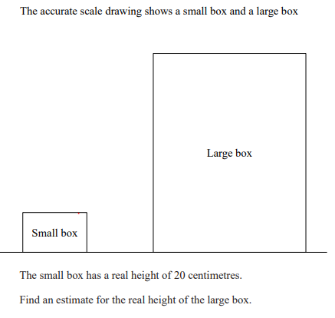
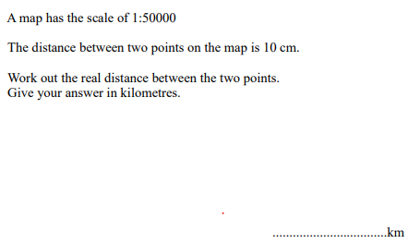
Scale Drawing
FOLLOW-UP WORK
Clip 864-871
https://www.mathsgenie.co.uk/gcse-may-june-2022-foundation-topics.html
Scale Drawings

Slide 24
Percentages
$$Convert the following decimals to percentages:$$ $$0.4$$ $$0.04$$ $$0.455$$ | $$How do you represent a decrease of 12\% as a \\ multiplier?$$ $$How do you represent a decrease of 5\% as a \\ multiplier?$$
$$I buy a pack of 20 pens for £5.$$ $$I sell each of them for 30p. Work out my \\ percentage profit.$$ | $$A car costing £15,000 depreciates in value by 15\% \\ each year. \\ How much will it be worth after 3 years?$$ $$How many years does it take the are to half in \\ value?$$
FOLLOW-UP WORK
Clips 55; 760-761; 95
https://www.mathsgenie.co.uk/gcse-may-june-2022-foundation-topics.html
Percentages; Percentage Change

Slide 25
Currency Conversion
FOLLOW-UP WORK
Clip707-708
https://www.mathsgenie.co.uk/gcse-may-june-2022-foundation-topics.html
Exchange Rates

Slide 26
Section D:
Geometry & Measures

Slide 27
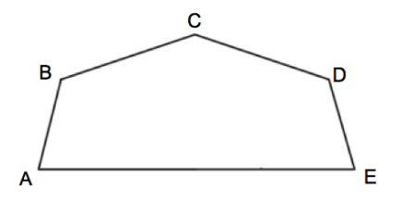
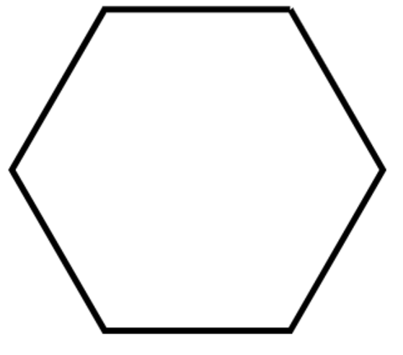
Polygons
$$a. What is the name of the shape ABCDE.$$ $$b. How many lines of symmetry does ABCDE have?$$ $$c. What type of angle is DEA?$$ | $$The shape above is a regular polygon.$$ $$a. What is the name of the polygon?$$ $$b. How many lines of symmetry does the shape have?$$ $$c. What is the order of rotational symmetry?$$
FOLLOW-UP WORK
Clips 822-828
https://www.mathsgenie.co.uk/gcse-may-june-2022-foundation-topics.html

Slide 28
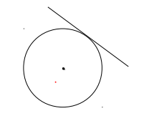
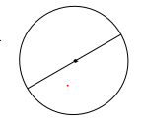
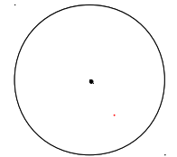
Circles
$$On the circle below, draw and label a:$$ $$chord$$ $$radius$$ | $$Write down the mathematical names for the \\ straight lines in each of these two diagrams$$
FOLLOW-UP WORK
Clips 592
https://www.mathsgenie.co.uk/gcse-may-june-2022-foundation-topics.html
Circles

Slide 29
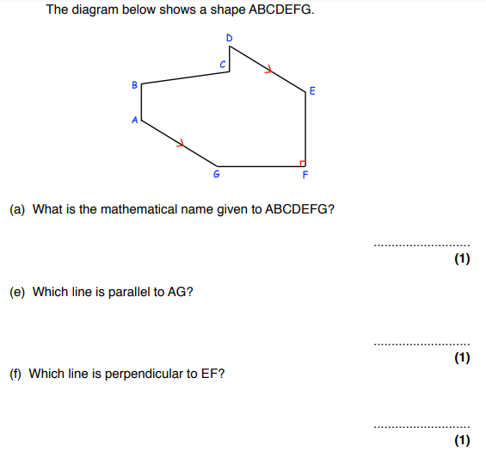
Parallel & Perpendicular Lines
$$Draw two parallel lines.$$ $$Draw two lines perpendicular to each other.$$
FOLLOW-UP WORK
Clip 821
https://www.mathsgenie.co.uk/gcse-may-june-2022-foundation-topics.html

Slide 30
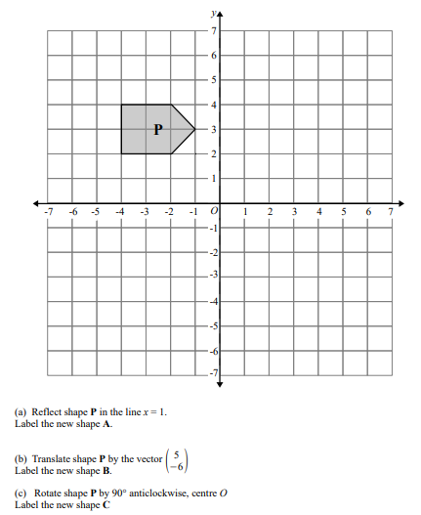
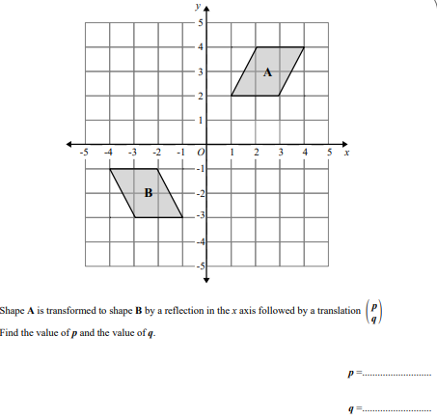
Transformations
FOLLOW-UP WORK
Clips 637-645: 648-654
https://www.mathsgenie.co.uk/gcse-may-june-2022-higher-topics.html
Transformations

Slide 31
Describing Transformations
Describe what single transformation maps shape A to Shape B.
FOLLOW-UP WORK
Clips 637-645: 648-654
https://www.mathsgenie.co.uk/gcse-may-june-2022-higher-topics.html
Transformations

Slide 32
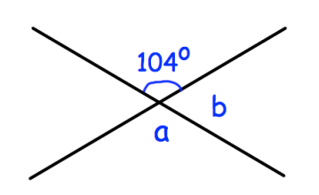
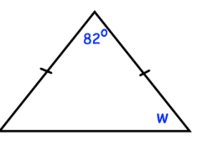
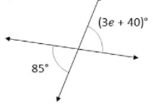
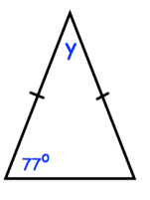
Angles Properties
$$Find a and b.$$ | $$Find w.$$
$$Find e.$$ | $$Find y.$$
FOLLOW-UP WORK
Clips 480; 484-491
https://www.mathsgenie.co.uk/gcse-may-june-2022-foundation-topics.html
Angles

Slide 33
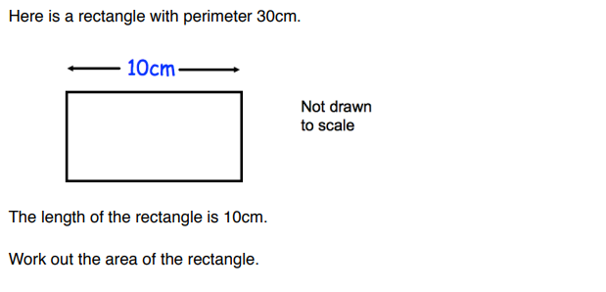
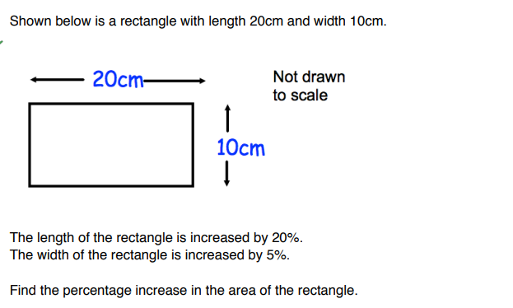
Area of a rectangle
FOLLOW-UP WORK
Clips 553-555
https://www.mathsgenie.co.uk/gcse-may-june-2022-foundation-topics.html
Area & Perimeter

Slide 34
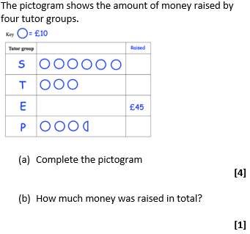
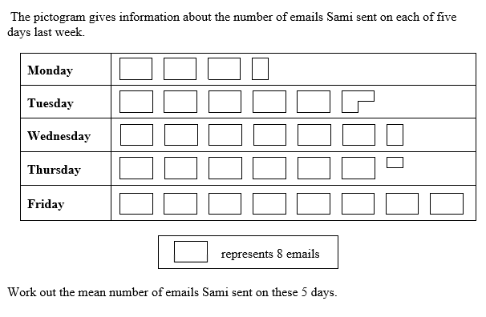
Pictograms
FOLLOW-UP WORK
Clip 426
https://www.mathsgenie.co.uk/gcse-may-june-2022-foundation-topics.html Pictograms

Slide 35
Section E: Statistics

Slide 36
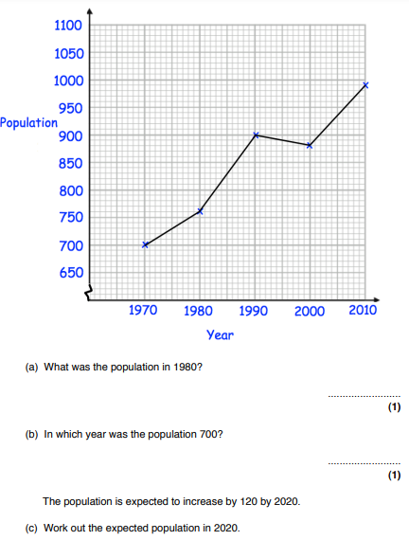
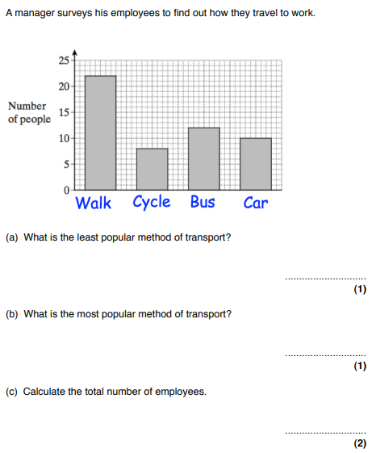
Interpret Graph
FOLLOW-UP WORK
Clip 425-433; 450-454
https://www.mathsgenie.co.uk/gcse-may-june-2022-foundation-topics.html

Slide 37
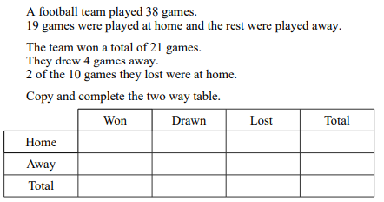
Two Way Tables
FOLLOW-UP WORK
Clip 424-424
https://www.mathsgenie.co.uk/gcse-may-june-2022-foundation-topics.html
Two Way Tables

Slide 38
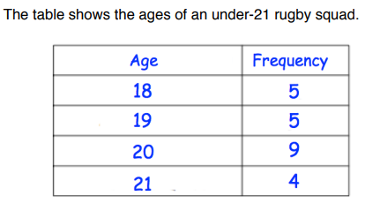
Mode and Median
$$Find the mode of:$$ $$4, 5, 4, 6, 6, 4, 3, 6, 8$$ $$red, blue, green, blue, yellow$$ | $$Find the median of:$$ $$5, 7, 10, 12, 15$$ $$5, 7, 8, 11, 12, 15$$
$$Find the mode.$$ $$Find the median.$$
FOLLOW-UP WORK
Clips 404, 409, 415-416, 419-420
https://www.mathsgenie.co.uk/gcse-may-june-2022-foundation-topics.html
Averages

Slide 39
Mean
$$Find the mean of:$$ $$4, 5, 4, 6, 6, 4, 3, 6, 7$$ | $$The mean of 4, 5, 5, 6 and x is 7. Find x.$$
$$Jim ran a mean distance of 13.2km in five days. \\ The next day, Jim ran 20km. \\ Find the mean distacne Jim ran in the six days.$$ | $$Find the mean$$
FOLLOW-UP WORK
Clips 405-408,417, 419-420
https://www.mathsgenie.co.uk/gcse-may-june-2022-foundation-topics.html
Averages

Slide 40
Section F: Probability

Slide 41
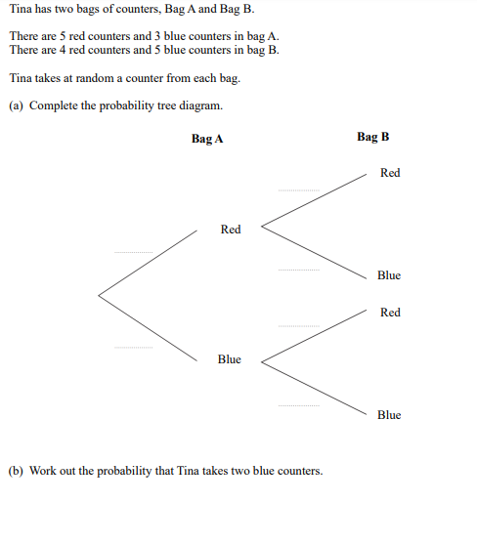
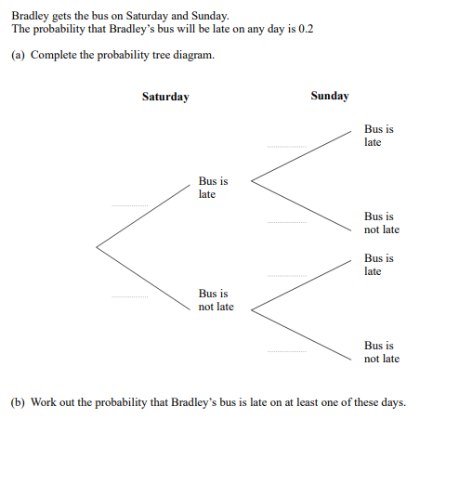
Tree Diagrams
FOLLOW-UP WORK
Clips 361-363
https://www.mathsgenie.co.uk/gcse-may-june-2022-foundation-topics.html
Probability Trees

Slide 42
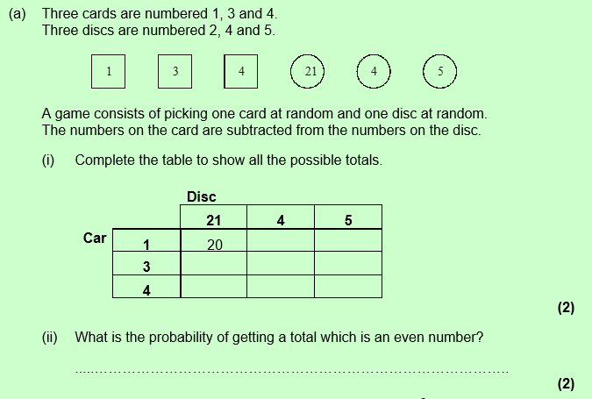
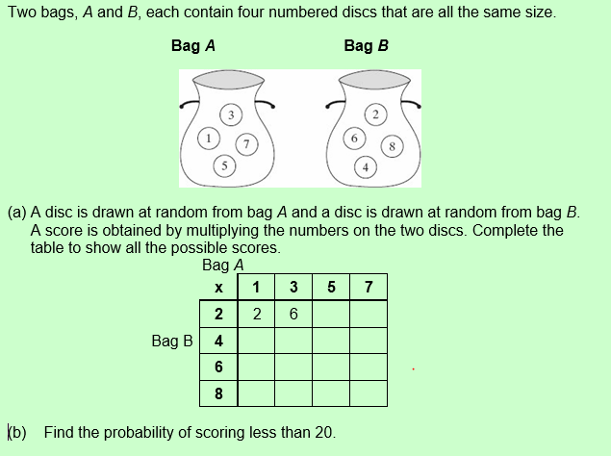
Combined Events
FOLLOW-UP WORK
Clips 358-360
https://www.mathsgenie.co.uk/gcse-may-june-2022-foundation-topics.html

Slide 43
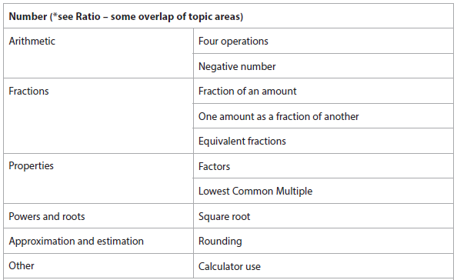
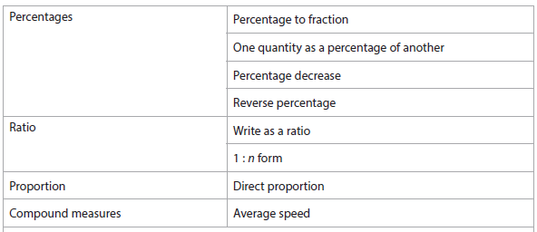
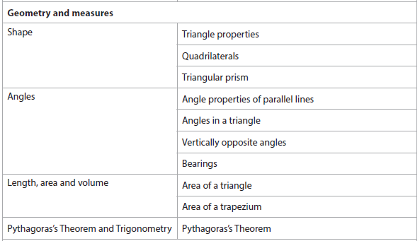
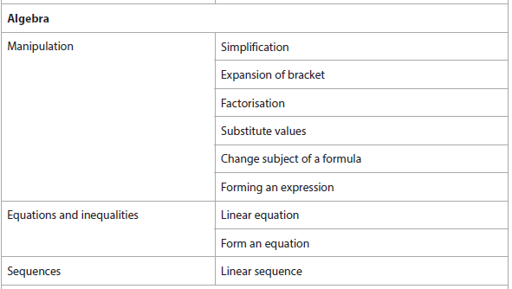
Advanced Information – 3F
Calculator

Slide 44
Section A: Number
These topics have been included in the previous revision booklet (paper 1) or in the first part of this booklet (paper 2).

Slide 45
Fractions
$$Write 12 as a fraction of 60. \\ Write your answer in its simplest form.$$ | $\frac{4}{5}=\frac{}{35}$ $\frac{}{8}=\frac{24}{32}$
$$What fraction of an hour is 48 minutes?$$ $$Write your answer in its simplest form.$$ | $$Is \frac{2}{7} or \frac{3}{8} larger? \\ Explain your answer clearly.$$
FOLLOW-UP WORK
Clips 62, 59, 61
https://www.mathsgenie.co.uk/gcse-may-june-2022-foundation-topics.html Fractions

Slide 46
Factors & Multiples
$$Write all the factors of 24.$$ | $$Find the LCM of 18 and 28. \\ Hint:Use the Venn diagram method.$$
$$All numbers have an even number of factors. \\ Give an example to show that this statement \\ is false.$$ | $$Two bells ring at 9am. \\ One bell rings every 12 minutes. \\ The other bell rings every 22 minutes. \\ Find the next time the bells ring at the same tine.$$
FOLLOW-UP WORK
Clips 27, 34-36
https://www.mathsgenie.co.uk/gcse-may-june-2022-foundation-topics.html Prime Factors, HCF and LCM

Slide 47
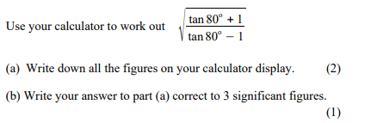
Calculator Use (Inc. Square Roots and rounding)
FOLLOW-UP WORK
Clips 101; 129
https://www.mathsgenie.co.uk/gcse-may-june-2022-foundation-topics.html Using a calculator

Slide 48
Section B: Algebra
These topics have been included in the previous revision booklet (paper 1) or in the first part of this booklet (paper 2).

Slide 49
Changing the Subject
$$Make a the subject of the formula:$$ $$y=aw+b$$ | $$Make a the subject of the formula:$$ $$y=\frac{a+5}{c}$$
$$Make a the subject of the formula:$$ $$y=b −2a$$ | $$Make a the subject of the formula:$$ $$y=4a^{2}$$ $$y=\sqrt{a −4}$$
FOLLOW-UP WORK
Clips 280-287
https://www.mathsgenie.co.uk/gcse-may-june-2022-foundation-topics.html
Changing the Subject of a Formula

Slide 50
Linear Equations
$$Solve 4x −1=22$$ $$Solve 5\left(3x+2\right)=100$$ | $$Solve \frac{3x}{4}+2=8$$ $$Solve \frac{3x+2}{4}=3.5$$
$$Solve 4x −1=2x+9$$ | $$Solve 10 −3x=2x −5$$
FOLLOW-UP WORK
Clips 176-186; 188-189
https://www.mathsgenie.co.uk/gcse-may-june-2022-foundation-topics.html
Solving Equations

Slide 51
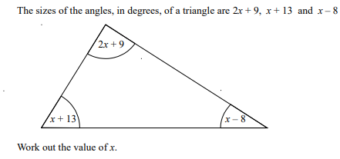
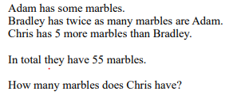
Forming an expression/equation
 | $$Pens are sold in packs of 6. Pencils are sold in$$ $packs of 7$. $$I sold x packs of pens and y packs of pencils \\ yesterday. Write an expression for the total \\ number of pens and pencils solde$$
 | $$There are x metres of wrapping paper. Write \\ an expression for the amount of wrapping \\ paper in cm.$$
FOLLOW-UP WORK
Clips 151-153
https://www.mathsgenie.co.uk/gcse-may-june-2022-foundation-topics.html
Forming & Solving Equations

Slide 52
Section C: Ratio, Proportion and Rates of Change
These topics have been included in the previous revision booklet (paper 1) or in the first part of this booklet (paper 2).

Slide 53
Compound Units
$$Write 40m per second in km per hour$$ | $$Write 4,000 kg/m^{3} in g/{cm}^{3}$$
$$Write 27km per hour in m per second$$ | $$Write 11 g/{cm}^{3} in kg/m^{3}$$
FOLLOW-UP WORK
Clips 724, 731, 737, 738
https://www.mathsgenie.co.uk/gcse-may-june-2022-foundation-topics.html
Compound Measures

Slide 54
Percentages
$$Convert the following percentages to fractions:$$ $$(Give your answer in its simplest form)$$ $$45\%$$ $$40.5\%$$ $$6\%$$ $$0.5\%$$ | $$Write 15 as a percentage of 25$$ $$Write 17 as a percentage of 30$$
 | $$40 is x\% of 200. What is x?$$
FOLLOW-UP WORK
Clips 82, 62, 76
https://www.mathsgenie.co.uk/gcse-may-june-2022-foundation-topics.html
Fractions, Decimals and Percentages

Slide 55
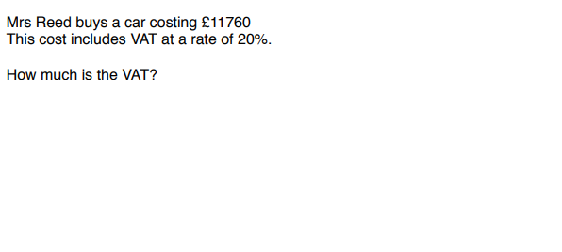
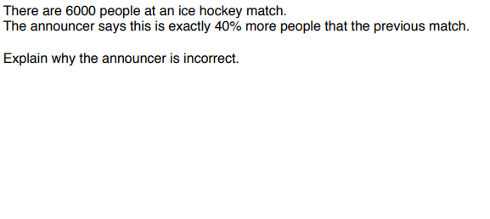
Reverse Percentages
FOLLOW-UP WORK
Clip 96
https://www.mathsgenie.co.uk/gcse-may-june-2022-foundation-topics.html
Reverse Percentages

Slide 56
Section D: Geometry & Measure
These topics have been included in the previous revision booklet (paper 1) or in the first part of this booklet (paper 2).

Slide 57
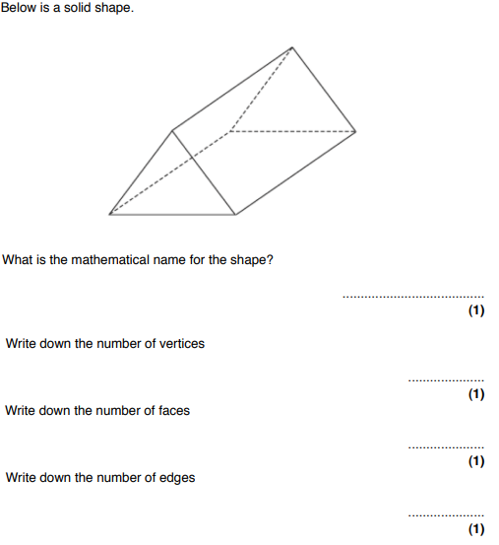
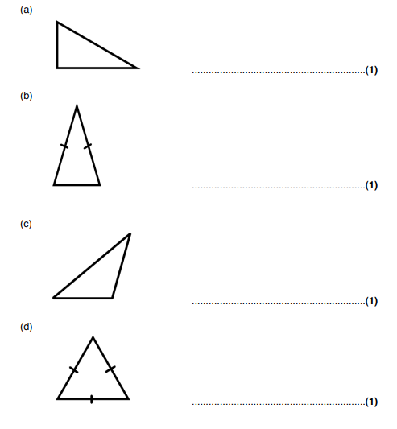
Shapes
$$What is the mathematical name of the triangles:$$
FOLLOW-UP WORK
Clips 823-826; 829-830
https://www.mathsgenie.co.uk/gcse-may-june-2022-foundation-topics.html

Slide 58
Shapes
FOLLOW-UP WORK
Clips 823-826; 829-830
https://www.mathsgenie.co.uk/gcse-may-june-2022-foundation-topics.html

Slide 59
Angles in Parallel Lines
FOLLOW-UP WORK
Clip 481-483; 490-491
https://www.mathsgenie.co.uk/gcse-may-june-2022-foundation-topics.html
Angles in Parallel Lines

Slide 60
Bearings
 | $$The bearing of point B from point A is 028°. \\ Find the bearing of A from B.$$ Hint: It is not drawn accurately – use parallel line rules to solve this problem
FOLLOW-UP WORK
Clip 492-496
https://www.mathsgenie.co.uk/gcse-may-june-2022-foundation-topics.html
Bearings

Slide 61
Area of Triangles & Trapeziums
 | $$Find the area of the trapezium$$
FOLLOW-UP WORK
Clip 557-559
https://www.mathsgenie.co.uk/gcse-may-june-2022-foundation-topics.html
Area & Perimeter

Slide 62
Pythagoras Theorem
$$Find the length of a$$ | $$Find the area of the triangle$$
$$Find the length of x$$ | $$Find the length of the two perpendicular sides.$$
FOLLOW-UP WORK
Clip 498-499; 501-502
https://www.mathsgenie.co.uk/gcse-may-june-2022-foundation-topics.html
Pythagoras

Slide 63
Section E: Probability
This topic has been included in the previous revision booklet (paper 1) or in the first part of this booklet (paper 2).

Slide 64
Probability Scale
FOLLOW-UP WORK
Clip 349-350
https://www.mathsgenie.co.uk/gcse-may-june-2022-foundation-topics.html
Probability Scale

Slide 65
Section F: Statistics
This topic has been included in the previous revision booklet (paper 1) or in the first part of this booklet (paper 2).

Slide 66
Frequency Polygons
FOLLOW-UP WORK
Clip 441
https://www.mathsgenie.co.uk/gcse-may-june-2022-foundation-topics.html
Frequency Polygons

Slide 67
Range & Comparison of Distributions
 | Hint: Compare Medians and Ranges
$$The range of test scores in year 9 was 35. \\ If the lowest score was 19, what was the highest \\ score?$$
FOLLOW-UP WORK
Clip 410, 414, 419-420, 432-43
https://www.mathsgenie.co.uk/gcse-may-june-2022-foundation-topics.html
Averages

